Slide 1
Case Study: Amazon’s Biased Hiring Bot and Collection of Employee Data
Group 3: Adi David, Gregory Katchis, Matt Kubisa, Jason Scott, Justin Sheehan
Professor George Weinschenk
CS 301: Ethical, Social, & Global Issues in Computing

Slide 2
Road Map
Summary of Amazon’s decision
Why Amazon created this AI
Pressures of recruitment
Competitors approaches to finding candidates
Facebook and Google
Applicant Tracking Software (ATS)
Algorithms
Amazon’s previous algorithms
Legal status of algorithms
User data for algorithm training
Amazon’s decision
Other potential decisions
Violations of ACM Codes and Gift of Fire Guidelines
Ethical analysis of Amazon’s decision
Notes:
(Don’t know whether anyone else is already planning to present this, but I (Justin) can do it if no one else is)
I, Greg, am planning to present this

Slide 3

Amazon’s Decision – Overview
In 2014, development began on an AI recruiting algorithm
Would rank resumes on a 1-5 star system
The goal was to give it a stack of resumes and it would return the top 5 candidates
The algorithm turned out to be biased against some resumes
Trained on Amazon’s past hires - predominantly men
Downgraded some phrases and data, including two all-women’s colleges
Amazon decided to cancel work on the algorithm
The algorithm was never used to evaluate actual candidates
Research and development was shifted into a much smaller-scale algorithm
Figure 1
Amazon AI Logo
(Engdahl, 2008)
Notes:
Justin
https://aws.amazon.com/blogs/startups/ai-or-die/

Slide 4
Discussion of Sub-Topics
Notes:
Matt

Slide 5
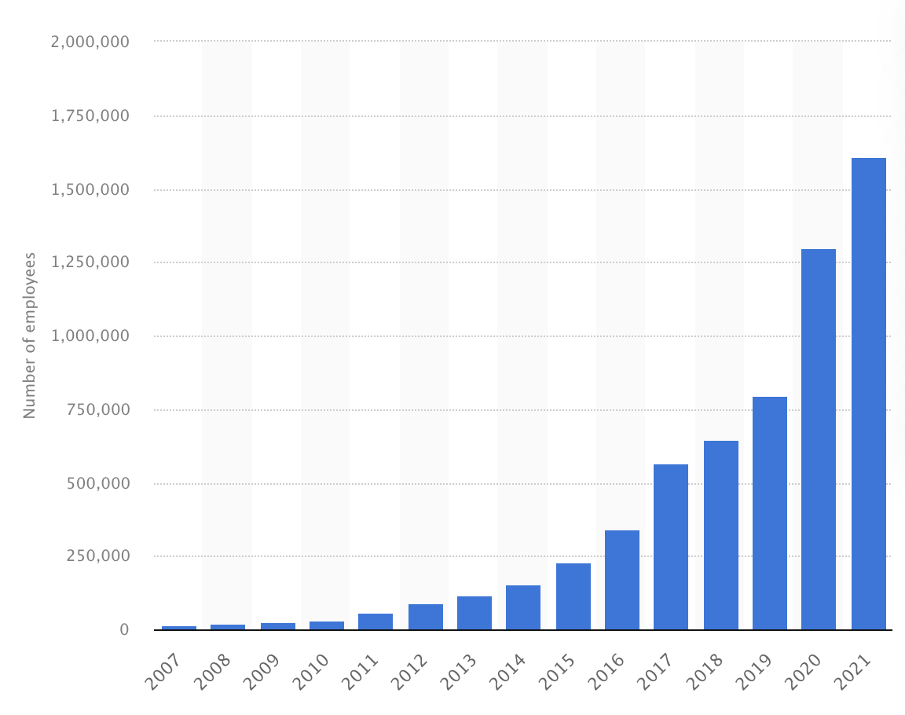
Why Amazon Created its AI
Amazon has ~1.7 million workers today
1 out of every 153 Americans works for Amazon
Amazon hires around 340 employees per day
Lot of work for Amazon’s HR department to sift through
They would need to manually scrub through 1000’s of resumes weekly
Figure 2
Amazon’s Employee Growth
(Statista, 2021)
Notes:
https://www.statista.com/statistics/234488/number-of-amazon-employees/ Jason

Slide 6

Other Causes
Figure 3
Employee Resource Center Logo
If the AI is successful, Amazon would have the groundwork to be able to hire an exponential amount of employees
Essential due to Amazon’s rapid growth
Amazon’s Employee Resource Center is an automated assistance center
Trained from the dataset of employees calling into it
Shows that Amazon is comfortable with integrating automation into their work environment
(TechTrend, 2021)
Notes:
Jason
img src https://the-tech-trend.com/reviews/what-is-amazon-erc-number-and-how-to-contact-amazon-hr-department/

Slide 7

Social Pressures
Can easily shift blame of controversial rejects/hires off an HR representative and onto the AI
Only works if happens a few times, not what ended up happening
Amazon wants to be ahead of the curve, or at least inline with other companies when it comes to their hiring process
Many companies incorporate Applicant Tracking Softwares
Amazon wants to take it a step further and make the software be in control of the whole process
Figure 4
Competition Companies to Amazon
(educative, 2019)
Notes:
Jason

Slide 8
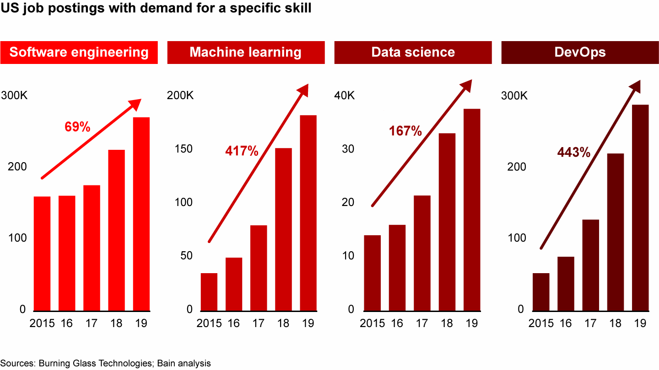
Difficulty Recruiting and Keeping Talented Employees
Shortage of qualified tech employees
More than 3 million cybersecurity positions unfilled in 2020
85 million tech worker shortage by 2030
Not just tech companies looking for tech employees
40% software engineering hires come from non–tech companies
Tech employees stay at one company for under 2 years
Need for extensive recruitment
Figure 5
Tech Recruitment Data
(Frick et al., 2021)
Notes:
Start of greg’s part
https://www.forbes.com/sites/larryenglish/2021/06/01/the-tech-talent-war-has-no-end-in-sight-heres-what-you-need-to-know/?sh=3654d2f85f2d
https://www.bain.com/insights/tech-talent-war-tech-report-2021/ ALSO LINK TO IMAGE
https://www.mckinsey.com/business-functions/mckinsey-digital/our-insights/tech-talent-tectonics-ten-new-realities-for-finding-keeping-and-developing-talent

Slide 9

Facebook Recruitment
Referrals from employees within Facebook
Viewed as best way of recruitment
Facebook looks for creators/builders
Looks for diverse candidates
Extensive Interview process
Phone interview (looks for professionalism)
Phone interview (technical interview)
Office tour (get candidate acclimated to environment)
Coding Interview
Figure 6
Facebook Logo
(Thousandlogos, 2021)
Notes:
https://www.businessinsider.com/how-facebook-finds-exceptional-employees-2016-2#facebook-looks-for-diverse-backgrounds-2
Facebook Logo https://1000logos.net/facebook-logo/

Slide 10

Google Recruitment
Referrals from Google employees
Hiring team to make decision
Interviewer first interviews candidate
If qualified, candidate is then judged by hiring team
Each hiring team member examines the candidate
Candidate must get approval from entire hiring team
Process makes sure the most qualified are hired
Figure 7
Google Logo
(Mollerup, 2015)
Notes:
https://www.cnbc.com/2018/01/10/google-uses-this-shocking-strategy-to-hire-the-best-employees.html
Link to photo https://www.freepnglogos.com/pics/google-logo

Slide 11

Applicant Tracking Software (ATS)
Applicant Tracking Software is software that directs and organizes the recruitment/hiring process for companies
ATS often includes AI systems that sort resumes for keywords
Speeds up hiring process
Hundreds of different ATSs
All major companies use some version of ATS
Figure 8
Oracle Taleo Logo
(Morrison, 2017)
Notes:
https://www.techtarget.com/searchhrsoftware/definition/applicant-tracking-system-ATS
Oracle Talio most popular ATS
Link to image https://talentmanagement360.com/talent-management-software-spotlight-oracle-taleo-cloud-service/

Slide 12
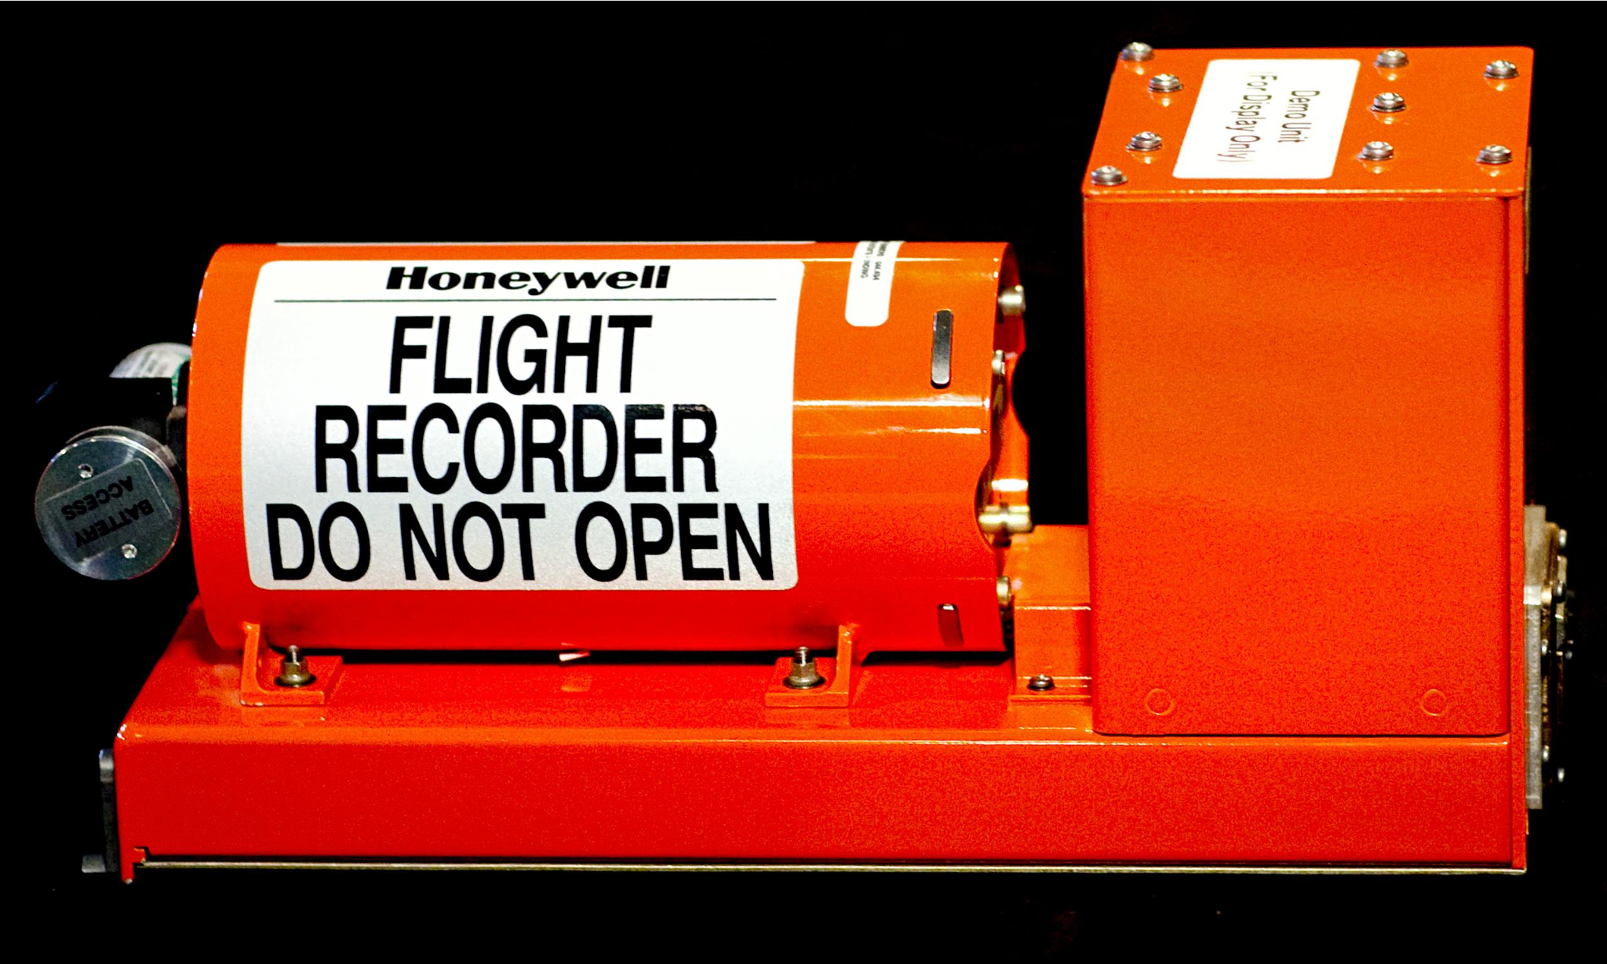
Keeping Data and Algorithms “Closed Source”
Why keep algorithms confidential?
Escape prosecution
Biased for profit
Hide from companies
How can the public allow this?
Black Box
Used in airplanes
Tracks flight and cockpit voice data
Opposite meaning for programmers
Refuse to disclose details
Inability to understand the algorithm
Figure 9
Black Box
(Jeffries, 2014)
Notes:
Adi

Slide 13
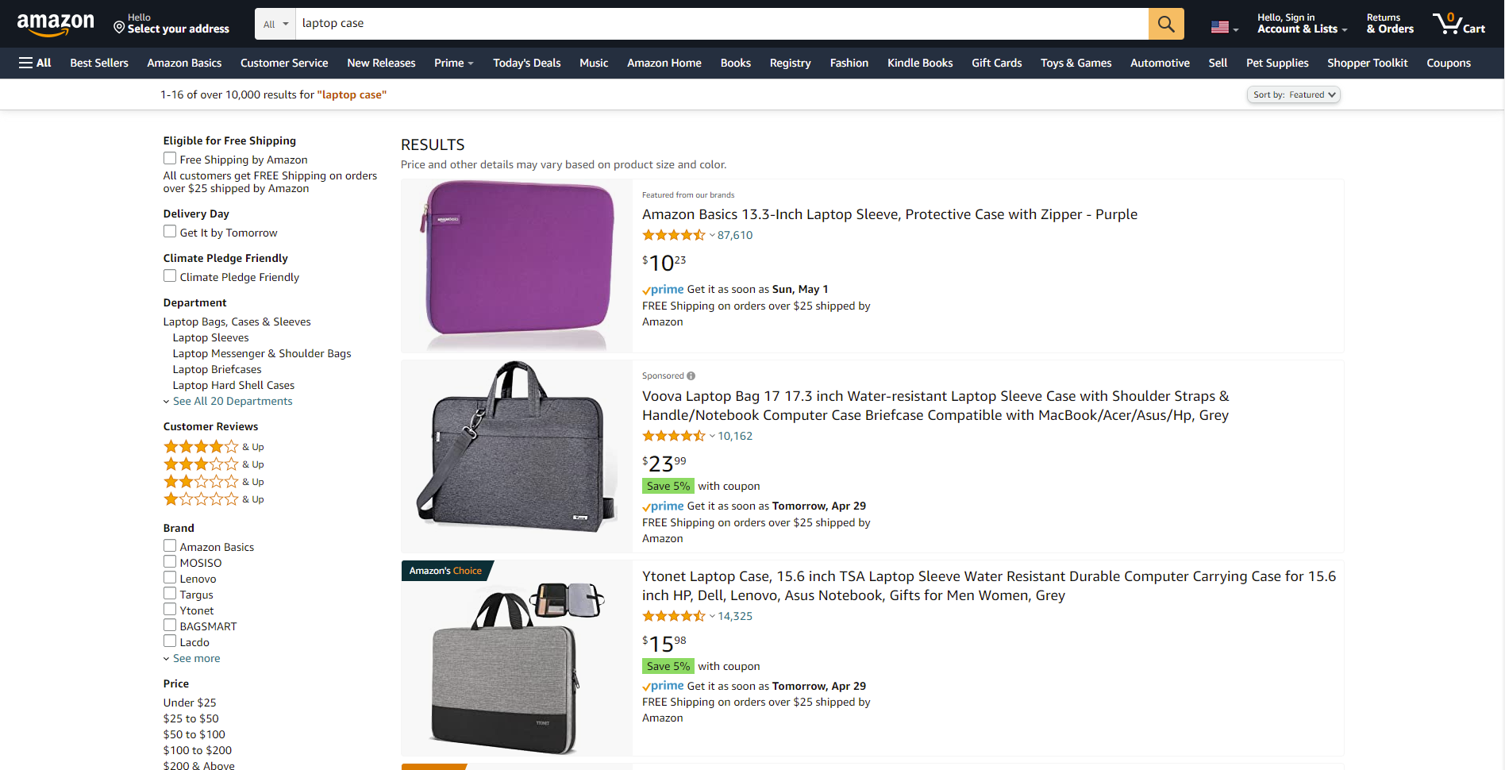
Amazon’s Previous Algorithm Biases
Search engine algorithm
Engineers approached WSJ
Amazon rejected unprofitable improvements
Forced promotion of Amazon Basics line
Denied allegations and refused disclosure
Prime same day delivery
Engineers approached Bloomberg
Favored white over black/latino neighborhoods
Service based on distance to warehouse
Pleaded ignorance
Strategic Ignorance:
Programmers/tech executives deny knowledge
Figure 10
Amazon search results for laptop sleeve

Slide 14

The Need for Updated Laws
Title VII
Federal law
Prohibits employment discrimination
Race, religion, sex, etc.
Remains true regardless of intentions
Difficult to sue
Failure to hire case
Lack information on policy/practice
Speculation in the judge’s eyes
Computer Fraud and Abuse Act (CFAA)
Unauthorized access/retrieval of data
Illegal to audit test websites
Violates terms of service
Create multiple accounts
Provide fake information
American Civil Liberties Union (ACLU)
Challenged CFAA in court (2018)
Allowed ACLU to audit test
Figure 11
ACLU
(Farokhmanesh, 2012)

Slide 15

Equal Employment Opportunity Commission
Enforces Title VII
Hearing held in 2016:
Panel of analysts and psychologists
Revealed benefits and downsides of big data
Helpful, but too biased right now
Recent initiative in October 2021:
EEOC developed initiative from hearing
Regulate company’s collection of big data
Ensure rejections comply with Title VII
Companies must provide:
Adoption and design of algorithm
Employment-related technologies
Application of the algorithm
Technical assistance
Promising initiative
Figure 12
U.S. EEOC
(EEOC, 2021)

Slide 16
User Data For Algorithm Training
Using user-provided data for AI training is a common industry practice
Usually by big companies with lots of access to user data
Sources of big data may include…
Social media posts: Facebook; Twitter; YouTube
Cloud computing: Amazon AWS; Google Cloud; Microsoft Azure
Alternative example of user data application:
Google repurposing CAPTCHA response data to train AI
Notes:
Matt

Slide 17
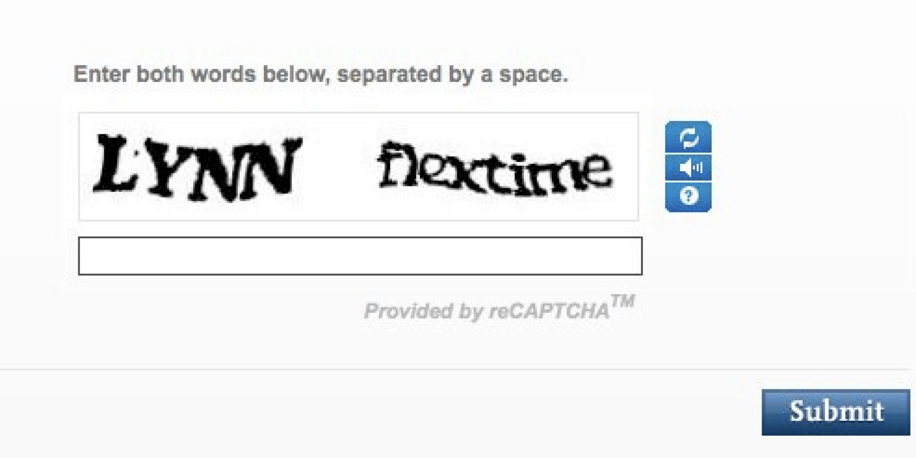
User Data For Algorithm Training
CAPTCHA = “Completely Automated Public Turing test to tell Computers and Humans Apart”
CAPTCHA’s primary purpose is to deter bot activity on websites
CAPTCHA has evolved over time
Earliest examples include deciphering visually corrupted letters and numbers
Modern examples oftentimes have the user pick out items from photographs
Figure 13
An example of an early CAPTCHA strategy.
(Reuters, 2013)
Notes:
Matt
Image source: https://www.huffpost.com/entry/captcha-defeated-by-computer-software_n_4168784
O’Malley, J. (2018). Captcha if you can: How you’ve been training AI for years without realizing it. Techradar. https://www.techradar.com/news/captcha-if-you-can-how-youve-been-training-ai-for-years-without-realising-it

Slide 18
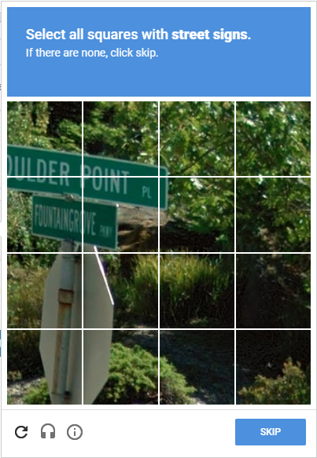
User Data For Algorithm Training
Google owns one of the most popular CAPTCHA services on the Internet
As such, they have access to the backend and the answers people provide to their CAPTCHA prompts
Alongside its main purpose, Google also uses their CAPTCHA as a data collection tool for training internal algorithms
Ex. finding results for Google Images, and Google Maps
These alternative uses for CAPTCHA data are not explicitly stated at the time of collection.
Figure 14
A prompt from Google’s image-based CAPTCHA
(Tuggy, 2017)
Notes:
Matt
https://meta.stackexchange.com/questions/296574/captcha-with-street-signs

Slide 19
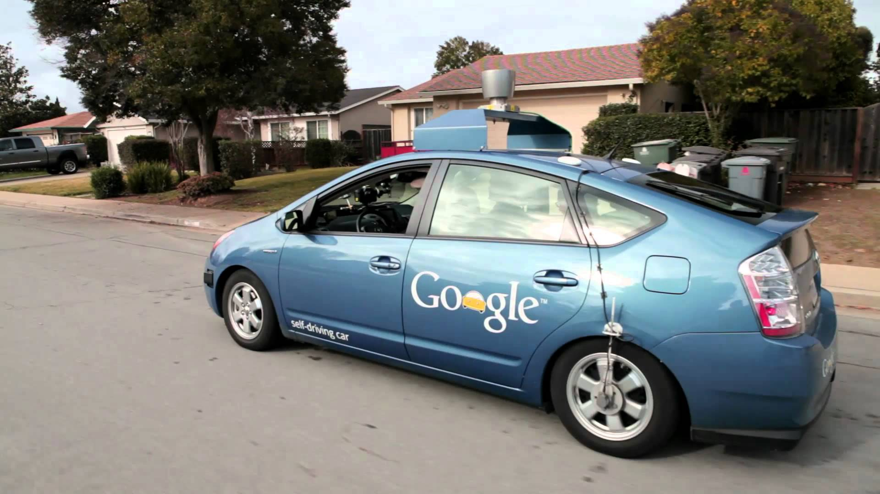
User Data For Algorithm Training
Over time, Google’s CAPTCHAS have become increasingly difficult for humans to solve
Bots are getting better at detecting the things being tested for
Much of what Google’s CAPTCHA has humans identify involves street signs and public areas.
Google is known to have been developing self-driving car technology
It’s possible Google has used CAPTCHA data to train it.
Figure 15
A self-driving car prototype by Google.
(Peters, 2015)
Notes:
Matt
Dzieza, J. (2019). Why CAPTCHAs have gotten so difficult. The Verge. https://www.theverge.com/2019/2/1/18205610/google-captcha-ai-robot-human-difficult-artificial-intelligence
Image source: https://www.talkandroid.com/233345-google-partners-with-automobile-suppliers-to-prepare-for-self-driving-cars/

Slide 20
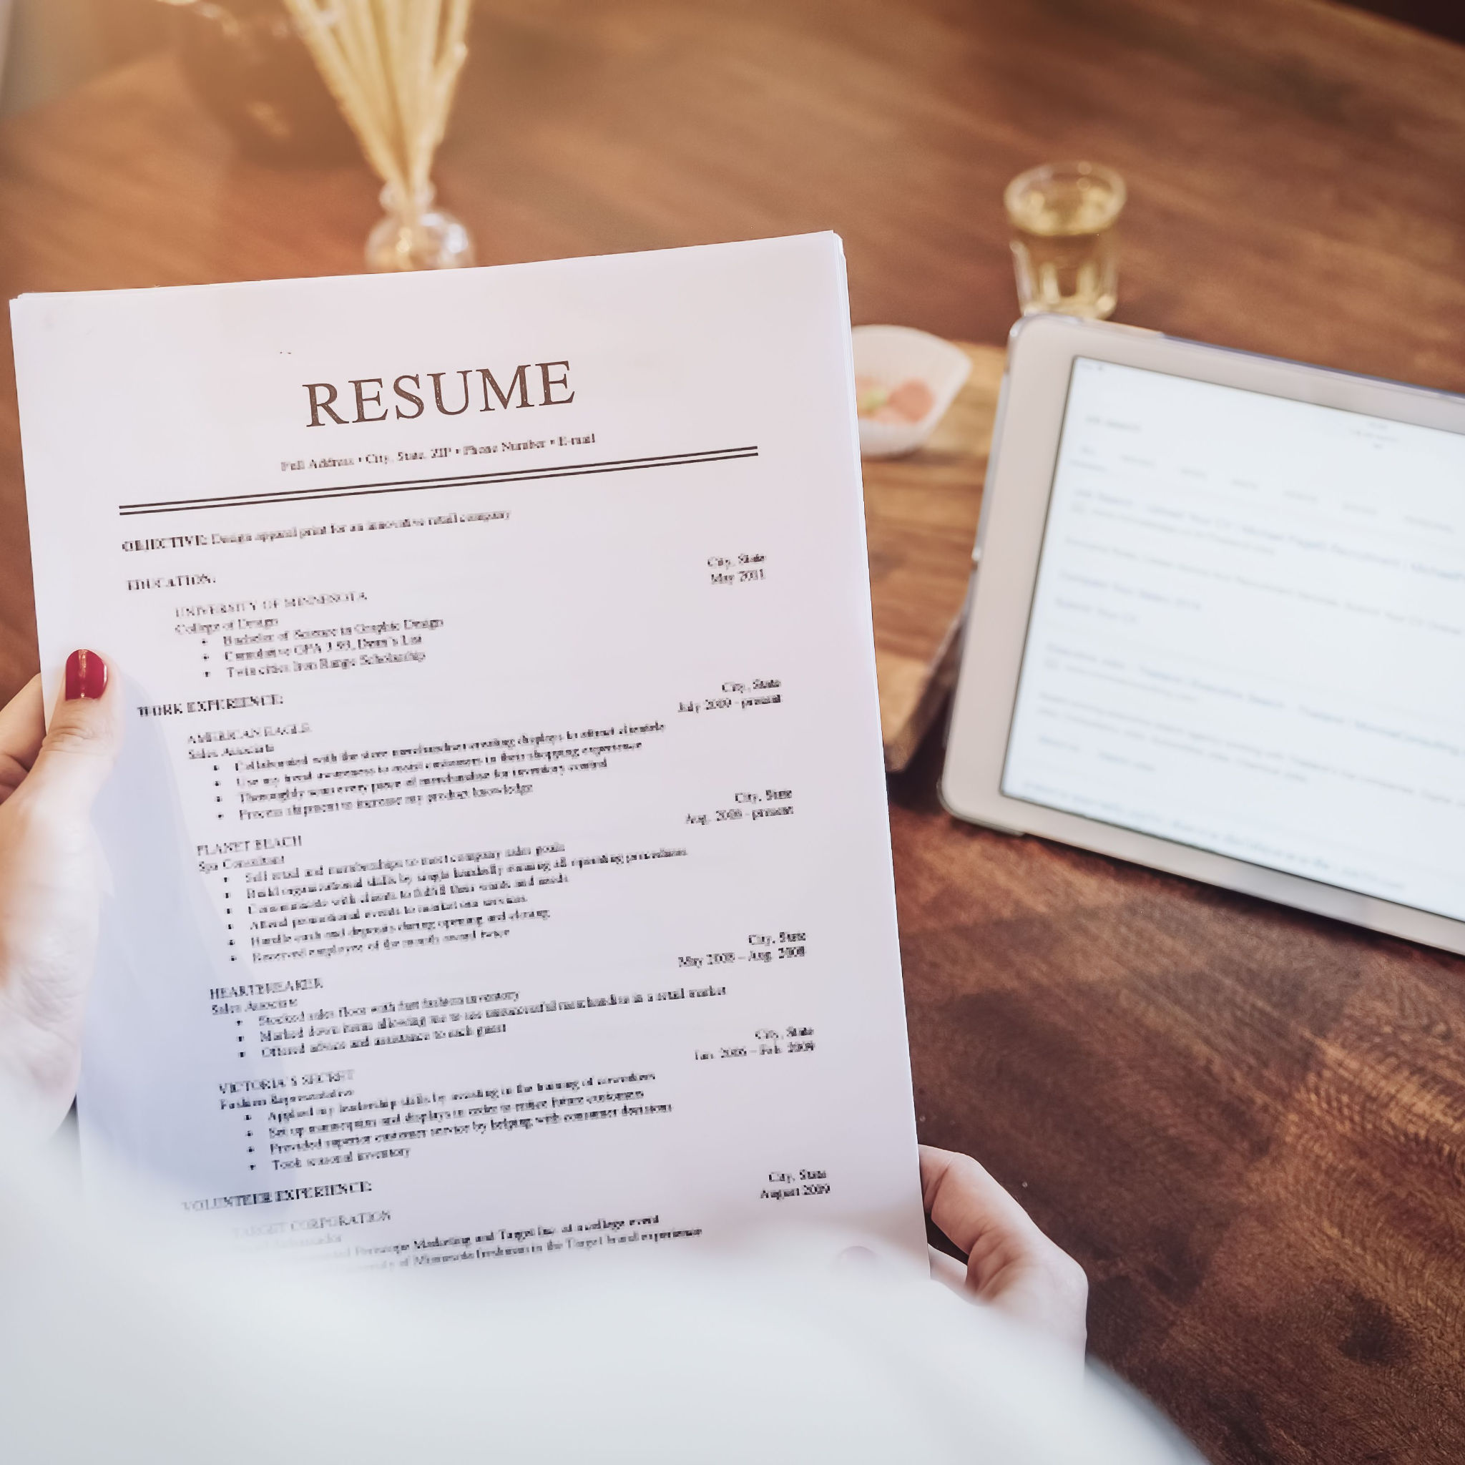
Issues with the System
Unfairly discriminated against applicants
Penalized words like “Women’s”
Valued two all-women’s colleges very low
Poor Data Collection
Self-selection bias
Bag of words approach
Unclear project requirements
Were told to make a system that would do everything
Were not told what “everything” was
Figure 16
Resume review
(Doyle, 2022)
Notes:
Start of Justin’s part
https://www.thebalancecareers.com/resume-keywords-and-tips-for-using-them-2063331

Slide 21

Amazon’s Decision
Amazon decided to cancel the system, but redirect resources towards making a much more scaled-back AI system.
Helps with basic tasks, like catching duplicate entries
All results are checked over by humans
Team formed in order to not waste previous resources.
This decision would be considered ethically acceptable
No longer uses data or algorithms that caused the bias
Works under human oversight
Figure 17
Human and AI Integration
(Maria Jesus Saenz, 2020)
Notes:
Justin https://sloanreview.mit.edu/article/designing-ai-systems-with-human-machine-teams/

Slide 22

Other Potential Decisions
Figure 18
Decision making
process
Keep the AI program, but retrain it
Ethically acceptable
New data must properly represent all potential hires
Inform their employees if they use their resumes
Shut down the program entirely
Ethically obligatory
Prevents the system from causing any harm
All the work for the system becomes wasted
Continue using the biased program
Ethically prohibited
Does nothing to help the minority groups who are effected
Creates a bad precedent for other companies to follow
(Depositphotos)
Notes:
https://depositphotos.com/stock-photos/decision-making.html

Slide 23
Impacts of Decision and Code Violations

Slide 24
Positive and Negative Rights Affected
Negative Right:
Existing Amazon employees’ right to privacy
Positive Right:
Female applicants’ right to a fair chance of being hired (independent of gender prejudice)
Notes:
Matt

Slide 25
Parties Affected by Bot’s Discontinuation
Affected Party | Effect type | Description
Amazon corporate/management | Negative | Loss of time and money on biased bot development Bad publicity
Amazon’s then-current employees | Positive | Personal resume data no longer being used (for this purpose) Amazon can’t find new employees => negotiating with current ones?
Potential new applicants | Positive | More level playing field for application process
Bot development team | Negative | Product was proven defective Time lost working on project Potential negative repercussions
Notes:
Matt

Slide 26
ACM Codes Violated by Biased Bot’s Development
Code Violated | How?
1.6: “Respect privacy.” | Current employee’s data was used to train bot without their knowledge or consent
2.8: “Access computing and communication resources only when authorized or when compelled by the public good.” | “Only when authorized” could suggest Amazon needed current employee’s consent first
3.7: “Recognize and take special care of systems that become integrated into the infrastructure of society.” | Biased bot was not fully understood, as its faults were left unaddressed for some time Amazon’s new hires could affect how the company operates
2.3: “Know and respect existing rules pertaining to professional work.” | Gender discrimination is illegal in American workplaces
Notes:
Matt

Slide 27
Gift of Fire 9.2.3 Guidelines Violated
“Design for real users.”
Bot would have failed in real-world applications due to its bias
User base includes female applicants
“Be open and honest about capabilities, safety, and limitations of software.”
Bot’s bias went unaddressed during development
Practice was only discontinued after media response
“Pay attention to defaults.”
Bot would assume incorrect information when confronted with gaps in training data resumes, contributing to bias
Notes:
Matt

Slide 28
Approaches from Historical Ethicists
Notes:
Matt

Slide 29
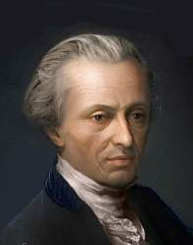
Deontology (Immanuel Kant)
Logic or reason determines rules of ethical behavior
Engineers in charge logically used resumes of current and former employees
Reasonable data set to collect to train the AI
Even though it biased men over women, it appeared logical
Ethical
Figure 19
Immanuel Kant
(Hereford)

Slide 30
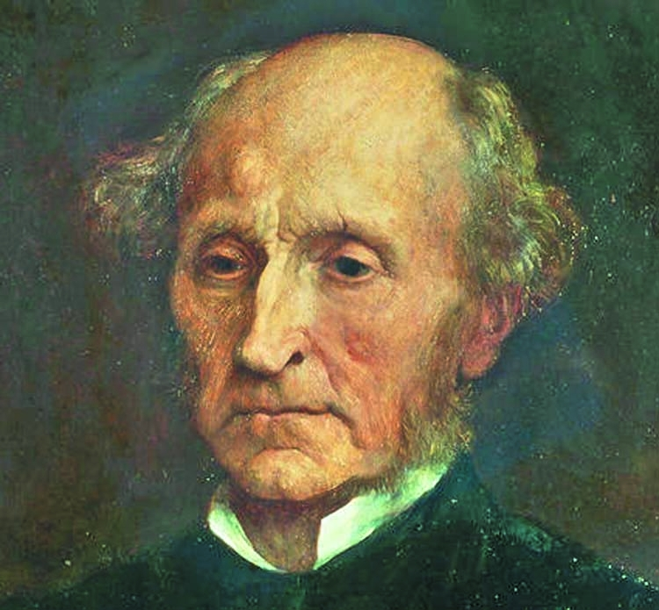
Aggregate Utility (John Stuart Mill)
Calculate the consequences of actions when making decisions:
Big data positives:
Free and easy collection of data
Data from the position they want to train the AI for
Big data negatives:
Small data set
Represents previous hires
Denies human bias in previous hires
Downfall:
Not understanding the consequences of all actions taken
Figure 20
John Stuart Mill
(2018)

Slide 31
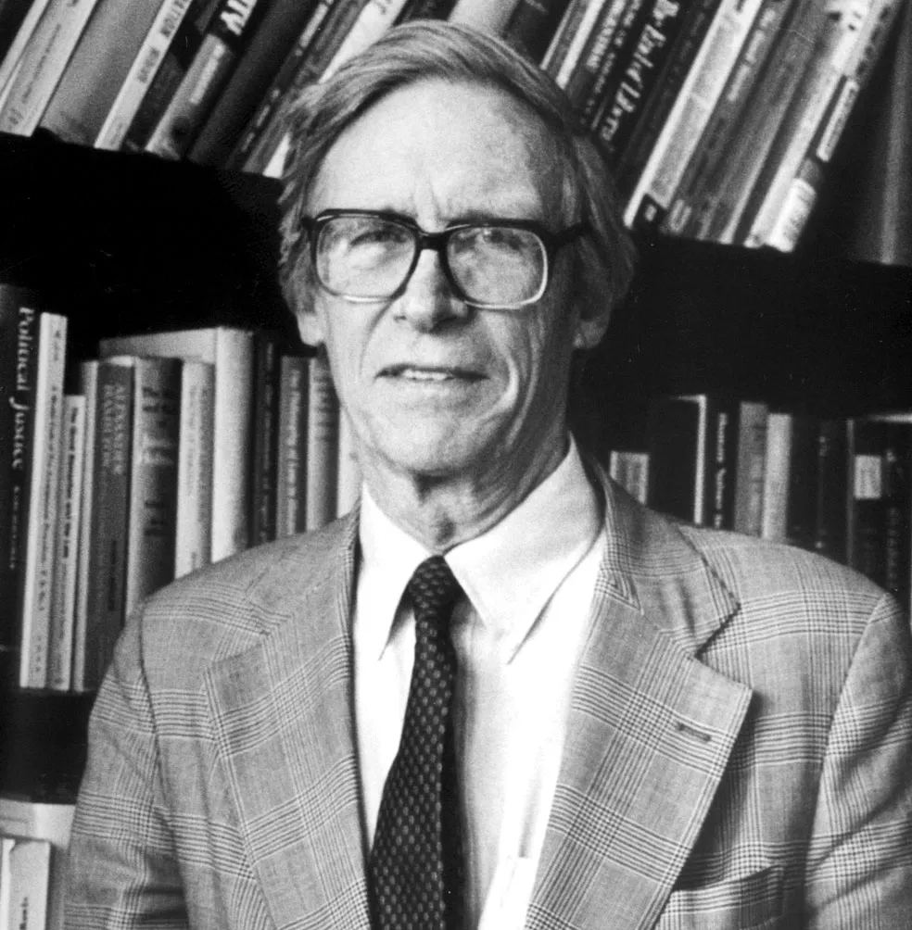
Veil of Ignorance (John Rawls)
Difference Principle:
Choice must benefit the least fortunate
Women in stem that receive less opportunities
Rawls would consider the AI unethical
Figure 21
John Rawls
(Sisodia, 2020)

Slide 32
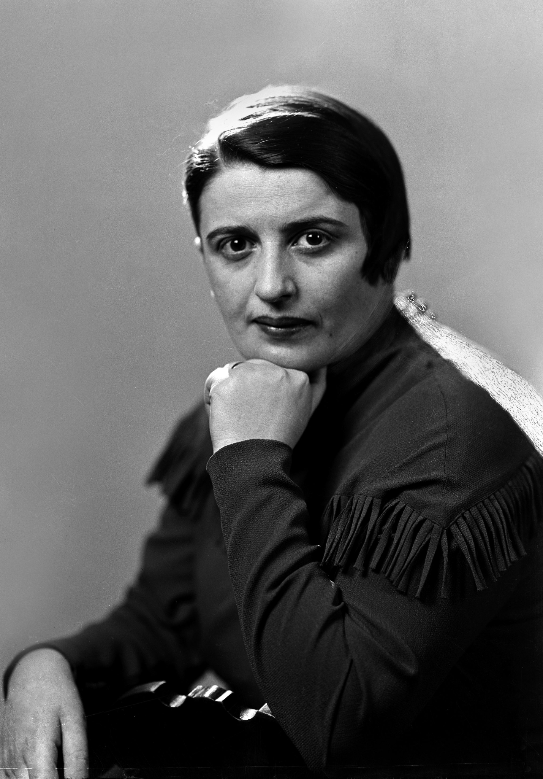
Ethical Egoism (Ayn Rand)
Best action benefits you the most
Ethicality depends on the results of the AI
If accepted applicants profit Amazon most
Dismiss discrmination if it provides profiting applicants
Unethical if the AI rejects profitable applicants
Figure 22
Ayn Rand
(Gessen, 2019)

Slide 33
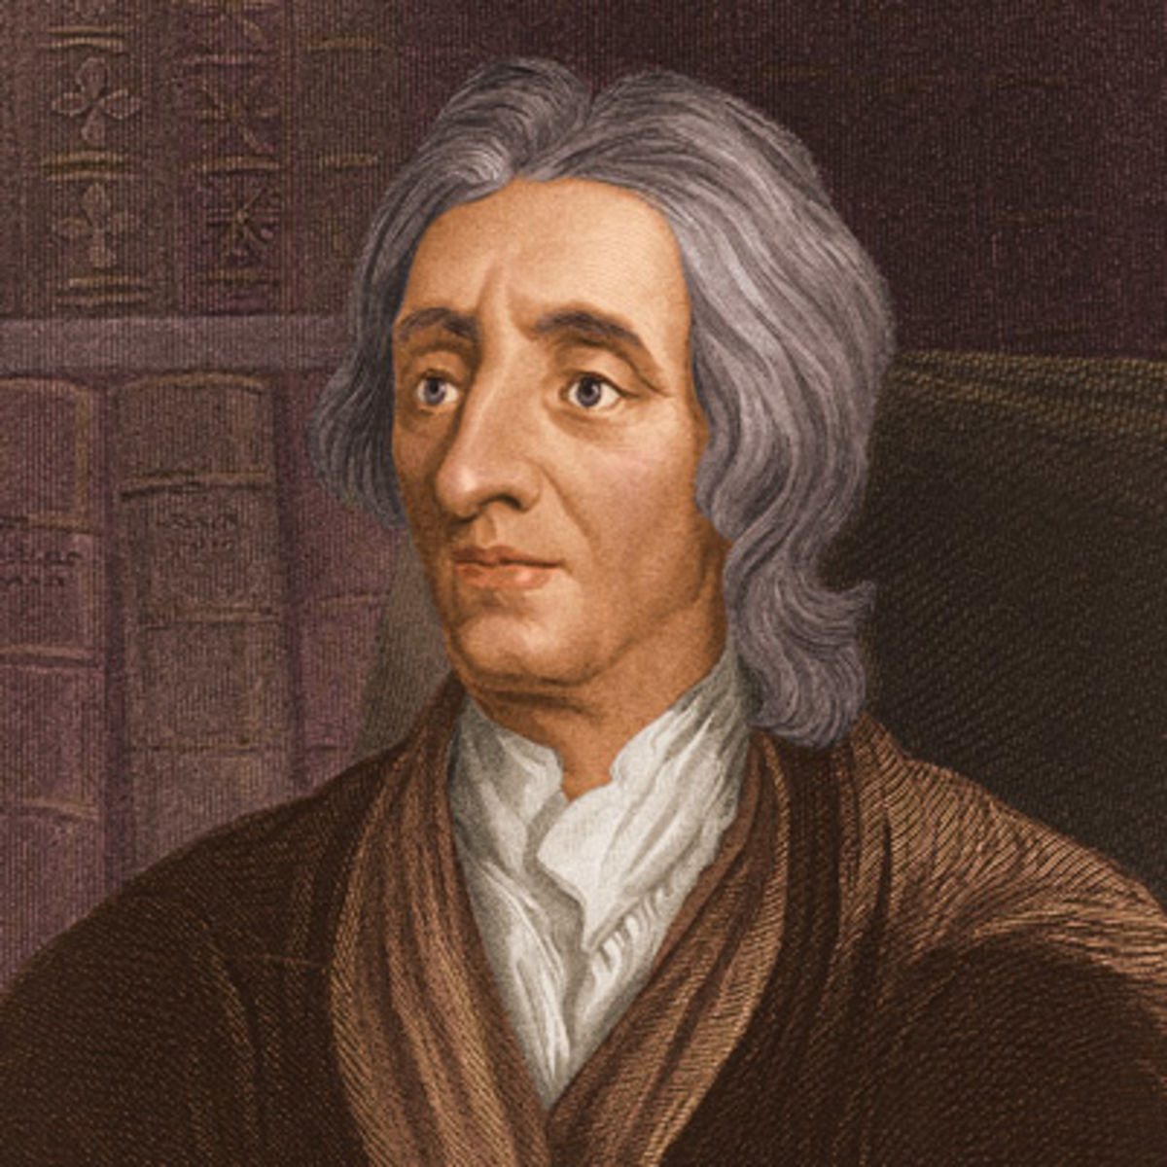
Beliefs of John Locke
Compensate others if you deprive them of resources
Resource: fair evaluation by employer
Female applicants deprived of this right
Disagrees with the AI’s use
Deprives female applicants of fair evaluations
No compensation
Unethical
Locke favors decisions of the majority
Big data used represents majority
New hires should represent the majority
Ethical
Figure 23
John Locke
(Szelenyi, 2009)

Slide 34
Criteria |  |  | Scale down the AI |  | Keep the AI, and retrain it |  | Shut down program entirely |  | Continue Using the Biased AI
Ethicist | Principle | Weighing Factor | Value | Weighted Value | Value | Weighted Value | Value | Weighted Value | Value | Weighted Value
Kant | Deontological Viewpoint | 0.05 | 10 | 0.5 | 30 | 1.5 | 0 | 0 | 50 | 2.5
Mill | Aggregate Utility | 0.15 | 35 | 5.25 | 40 | 6 | 35 | 5.25 | 20 | 3
Rawls | Veil of Ignorance | 0.35 | 40 | 14 | 40 | 14 | 40 | 14 | 0 | 0
Rand | Ethical Egoism | 0.2 | 40 | 8 | 45 | 9 | 0 | 0 | 20 | 4
Locke | Compensation to Those Deprived | 0.3 | 40 | 12 | 30 | 9 | 15 | 4.5 | 25 | 7.5
Totals: |  | 1 |  | 39.75 |  | 39.5 |  | 23.75 |  | 17
Ethical Analysis Decision Matrix

Slide 35
Conclusions

Slide 36
Conclusions
We believe Amazon made the right choice in scaling down their AI hiring bot program.
The bot’s discontinuation was a temporary win for the privacy of Amazon’s employees, as their data was no longer being used in training the software
Amazon’s decision process would mostly align with that of John Rawls, as the biased bot harmed female applicants, and its data collection affected the rights of privacy of Amazon employees
Many of Amazon’s practices were industry standard, including using AI in hiring processes, finding alternative uses for collected data, and making their algorithms closed-source
Notes:
Matt

Slide 37
References
ACLU. (2019, May 22). Sandvig v. Barr — challenge to cfaa prohibition on uncovering racial discrimination online. https://www.aclu.org/cases/sandvig-v-sessions-challenge-cfaa-prohibition-uncovering-ra
Cial-discrimination-online
Blumberg, S., Kouba, R., Thareja, S., & Wiesinger, A. (2022, April 15). Tech talent tectonics: ten new realities for finding, keeping, and developing talent. https://www.mckinsey.com/business-functions/mckinsey-digital/our-insights/tech-talent-tectonics-ten-new-realities-for-finding-keeping-and-developing-talent
Coppola, D. (2022, February 14)[Image]. Number of Amazon employees from 2007 - 2021. https://www.statista.com/statistics/234488/number-of-amazon-employees/
EEOC. (2016). Use of big data has implications for equal employment opportunity, panel tells EEOC. https://www.eeoc.gov/newsroom/use-big-data-has-implications-equal-employment-oppor
tunity-panel-tells-eeoc
EEOC. (2021, October 28). EEOC launches initiative on artificial intelligence and algorithmic fairness.https://www.eeoc.gov/newsroom/eeoc-launches-initiative-artificial-intelligence-and-algorithmic-fairness
EEOC. (n.d.). Title VII of the Civil Rights Act of 1964. https://www.eeoc.gov/statutes/title-vii-civil-rights-act-1964
Farokhmanesh, M. (2012, December 23)[Image]. ACLU warns against blaming video games for Newtown tragedy too quickly https://www.polygon.com/2012/12/23/3797762/aclu-warns-against-blaming-video-games
-for-newtown-tragedy-too-quickly
English, L. (2021, June 01). The tech talent war has no end in sight. here's what you need to know. https://www.forbes.com/sites/larryenglish/2021/06/01/the-tech-talent-war-has-no-end-in-sight-heres-what-you-need-to-know/?sh=3654d2f85f2d
Fawcett, A. (2019, September 13)[Image]. Why a FAANG company may not be right for you. https://www.educative.io/blog/why-a-faang-company-may-not-be-right-for-you
Feloni, R. (2016, February 17). Facebook's head of recruiting explains the company's top 3 approaches to finding exceptional employees. https://www.businessinsider.com/how-facebook-finds-exceptional-employees-2016-2#facebook-looks-for-diverse-backgrounds-2
Frick, J., George, K., & Coffman, J. (2022, February 23). The Tech Talent War is global, cross-industry, and a matter of survival. https://www.bain.com/insights/tech-talent-war-tech-report-2021/
Fussell, S. (2019, September 18). Algorithms are people. https://www.theatlantic.com/technology/archive/2019/09/is-amazons-search-algorithm-biased-its-hard-to-prove/598264/
Gessen, M. (2019, June 6)[Image]. The persistent ghost of Ayn Rand, the forebear of zombie neoliberalism. https://www.newyorker.com/news/our-columnists/the-persistent-ghost-of-ayn-rand-the-forebear-of-zombie-neoliberalism
Goodman, R. (2018, October 12). Why Amazon’s automated hiring tool discriminated against women. https://www.aclu.org/blog/womens-rights/womens-rights-workplace/why-amazons-autom

Slide 38
References (cont.)
Hereford, Z. (n.d.)[Image]. Immanuel Kant (1724 -1804). https://www.essentiallifeskills.net/immanuelkant.html
Jeffries, S. (2014, March 31)[Image]. Secrets of the black box: how does MH370's flight recorder work?https://www.theguardian.com/world/2014/mar/31/airplane-black-box-flight-recorders-investigators
McCracken, H. (2019, April 11). Meet the woman behind Amazon’s explosive growth. https://www.fastcompany.com/90325624/yes-amazon-has-an-hr-chief-meet-beth-galetti
Mollerup P. (2015, September 2). Yes, Google has a new logo- but why?. [Photograph]. https://theconversation.com/yes-google-has-a-new-logo-but-why-46976
Morrison S. (2017, July 31). Talent management software spotlight: Oracle Taleo cloud service. [Photograph]. https://talentmanagement360.com/talent-management-software-spotlight-oracle-taleo-cloud-service/
Omoh, R. (2018, January 10). Top google recruiter: Google uses this 'shocking' strategy to hire the best employees. https://www.cnbc.com/2018/01/10/google-uses-this-shocking-strategy-to-hire-the-best-employees.html
Singhal, A.(2021, May 27)[Image]. What is Amazon ERC number and how to contact Amazon HR department. https://the-tech-trend.com/reviews/what-is-amazon-erc-number-and-how-to-contact-amazon-hr-department/
Sisodia, A. (2020, June 10)[Image]. John Rawls. https://ashnasisodia.com/political-science-blogs/f/john-rawls
St-Jean, E., & Thibodeau, P. (2020, November 30). What is an applicant tracking system (ATS) and how does it work? https://www.techtarget.com/searchhrsoftware/definition/applicant-tracking-system-ATS
Szelenyi, I. (2009, September 10). John Locke: equality, freedom, property, and the right to dissent.
https://brewminate.com/john-locke-equality-freedom-property-and-the-right-to-dissent/
ThousandLogos(2021, December 23). Facebook logo. [Photograph]. https://1000logos.net/facebook-logo/
Doyle, A. (2022, February 20). Get your resume noticed with resume keywords. https://www.thebalancecareers.com/resume-keywords-and-tips-for-using-them-2063331
Maria Jesus Saenz, E. R. (2020, March 18). Designing AI systems with human-machine teams. https://sloanreview.mit.edu/article/designing-ai-systems-with-human-machine-teams/
Depositphotos, I. (n.d.). Decision making stock photos, royalty free decision making images. https://depositphotos.com/stock-photos/decision-making.html
Engdahl, S. (2008). AI or Die. https://aws.amazon.com/blogs/startups/ai-or-die/

